Slide 1
Statistical concepts for ’omics data analysis
February 23, 2021
Dr. ir. Perry Moerland
Bioinformatics Laboratory
Amsterdam UMC
University of Amsterdam
p.d.moerland@amsterdamumc.nl
Graduate School ‘Bioinformatics’
Some material courtesy of Robert Duin and David Tax

Slide 2
Statistical concepts for ’omics data analysis
High-dimensional data
  10,000s of genes, transcript variants, proteins, metabolites
  100,000s of single nucleotide polymorphisms, epigenetic markers
  In general, much less samples: ~100s at best
Unsupervised: clustering, principal component analysis
Differential expression
  statistical tests
  multiple testing
Experimental design
Supervised: classification
Generally applicable: next-generation sequence data analysis, for example

Slide 3
Context
Human (healthy - ill)
Genome
mRNA isolation
Information on gene activity
Information on illness
Role of genes in disease

Slide 4
Gene expression data
Samples
8.87 9.67 … 7.33
.
.
.
0.22 1.87 1.32 … 0.89
.
.
.
.
0.35 0.67 … 1.67
Genes
Gene expression profile
Expression
Levels
Sample expression profile

Slide 5
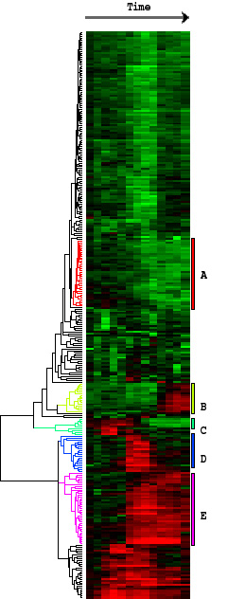
log(Cy5/Cy3)
< 0:
≥ 0:
Clustering
Unsupervised: classes are not pre-defined
Goal: grouping similar objects and visualization
  Hierarchical clustering
  K-means
  Cluster validation
  Principal component analysis
Data
Black Box

Slide 6
Classification
Supervised: classes are defined
Goal: building models for future predictions
Feature
selection
Data
Black Box
Model
: Data
Classes
Classes
Model can not always be
represented graphically
Normal vs cancer
Cancer subtypes

Slide 7
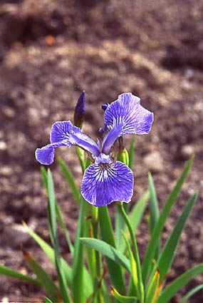
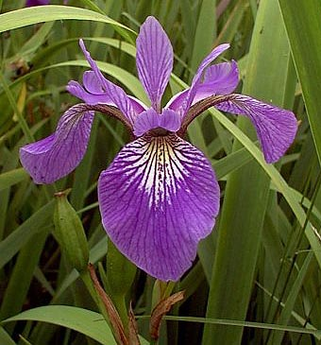
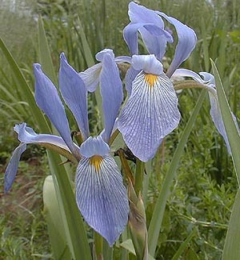
Supervised learning (I)
Objects
Data collection
Train
classifier
with
data
and
class
labels
Sepal length
Sepal width
Setosa
Petal length
Class labels
Petal width
Versilcolor
Virginica
Notes:
7

Slide 8
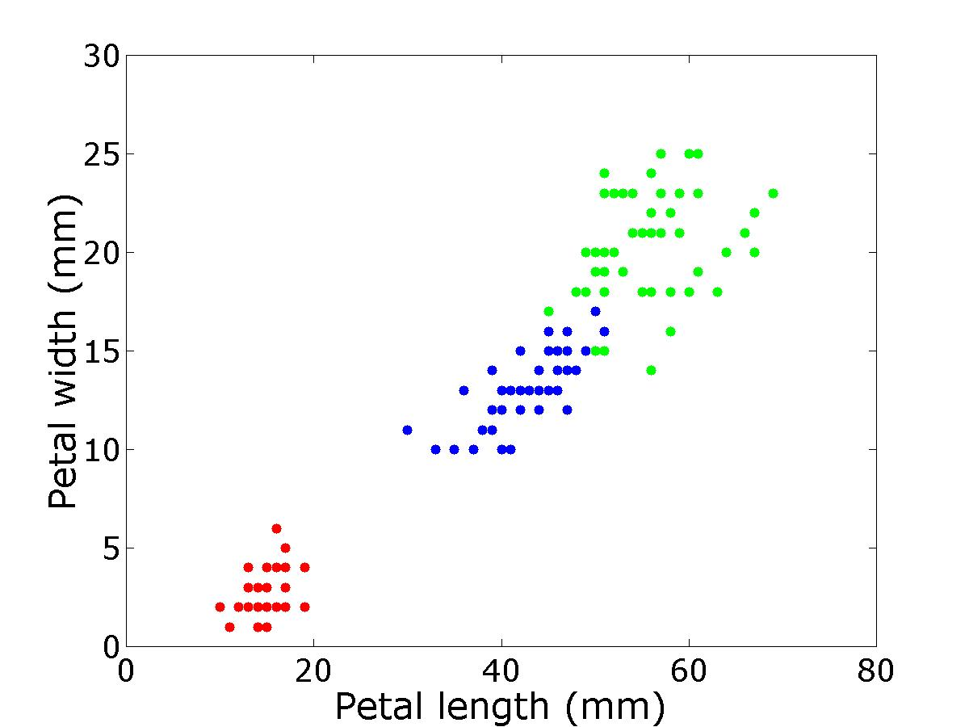
Supervised learning (II)
Classification
Virginica
Setosa
Versilcolor
Notes:
8

Slide 9
Unsupervised learning (I)
Objects
Data collection
Explore
data
without
class
labels:
Clustering,
PCA
Sepal length
Petal length
Setosa
Sepal width
Class labels
Petal width
Versilcolor
Virginica
Notes:
9

Slide 10
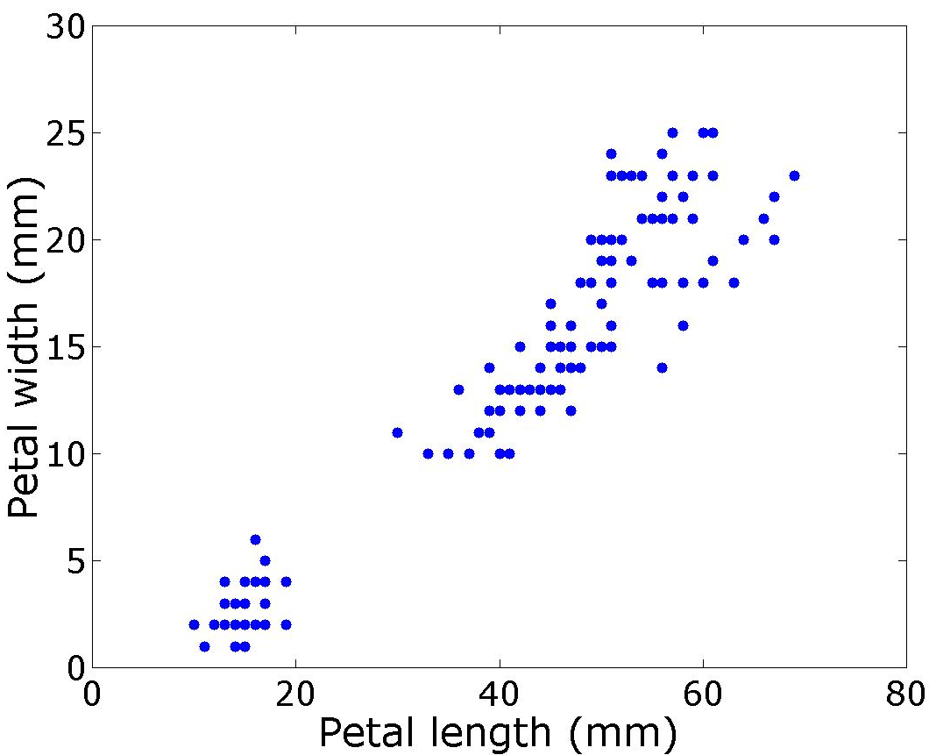
Unsupervised learning (II)
Clustering
Virginica
?
Versilcolor
Setosa
Notes:
10
Now without the colours.

Slide 11
What is a cluster?
Clustering: finding natural groups in data...
  which themselves are far apart
  in which objects are close together
Define what is “far apart” and “close together”:
  Need a distance measure or dissimilarity measure
  This measure should capture what we think is important for the grouping
  The choice for a certain distance measure is often the most important choice in clustering!
There is no such thing as the objective clustering
Notes:
11

Slide 12
What is a cluster in bioinformatics?
Clustering gene expression data, for example:
Genes: similar ~ co-expression ~ co-regulation ~
same pathway / same function
Samples: similar ~ same type of tissue
Used for discovery of new subclasses in tumors
Protein/protein complex
Genes
DNA regulatory elements
Notes:
12

Slide 13
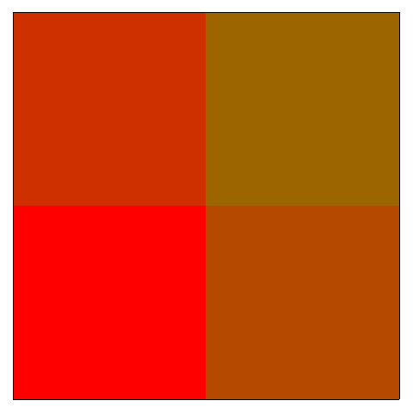
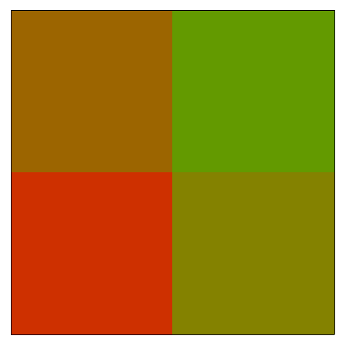
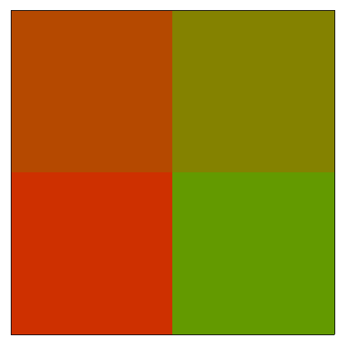
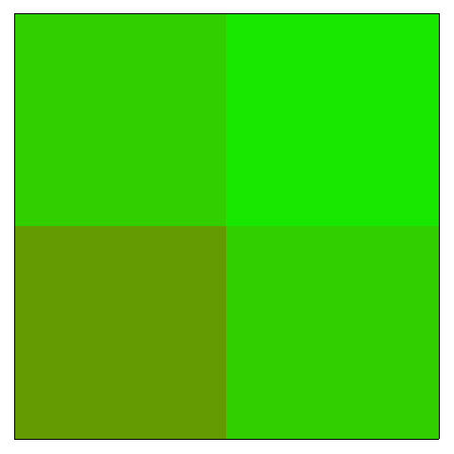

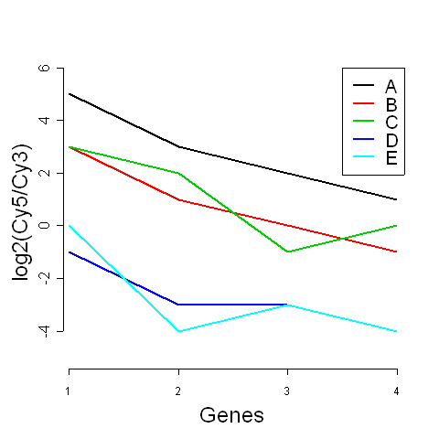
Visualisation of gene expression data (I)
array
A B C D E
A B C D E
gene1 5 3 3 -1 0
gene2 3 1 2 -3 -4
gene3 2 0 -1 -3 -3
gene4 1 -1 0 -4 -4
gene
2 4
1 3
Profiles (arrays):
log2(Cy5/Cy3)

Slide 14
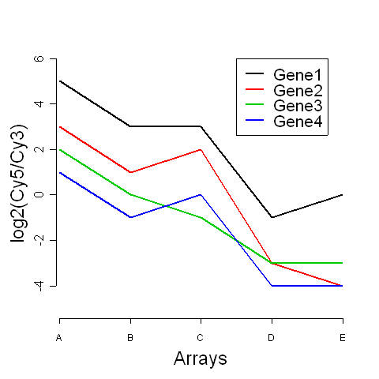
Visualisation of gene expression data (II)
array
A B C D E
A B C D E
gene1 5 3 3 -1 0
gene2 3 1 2 -3 -4
gene3 2 0 -1 -3 -3
gene4 1 -1 0 -4 -4
gene
2 4
1 3
Profiles (genes):
log2(Cy5/Cy3)

Slide 15
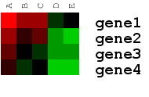
Visualisation of gene expression data (III)
array
A B C D E
A B C D E
gene1 5 3 3 -1 0
gene2 3 1 2 -3 -4
gene3 2 0 -1 -3 -3
gene4 1 -1 0 -4 -4
gene
2 4
1 3
Matrix representation:
log2(Cy5/Cy3)

Slide 16
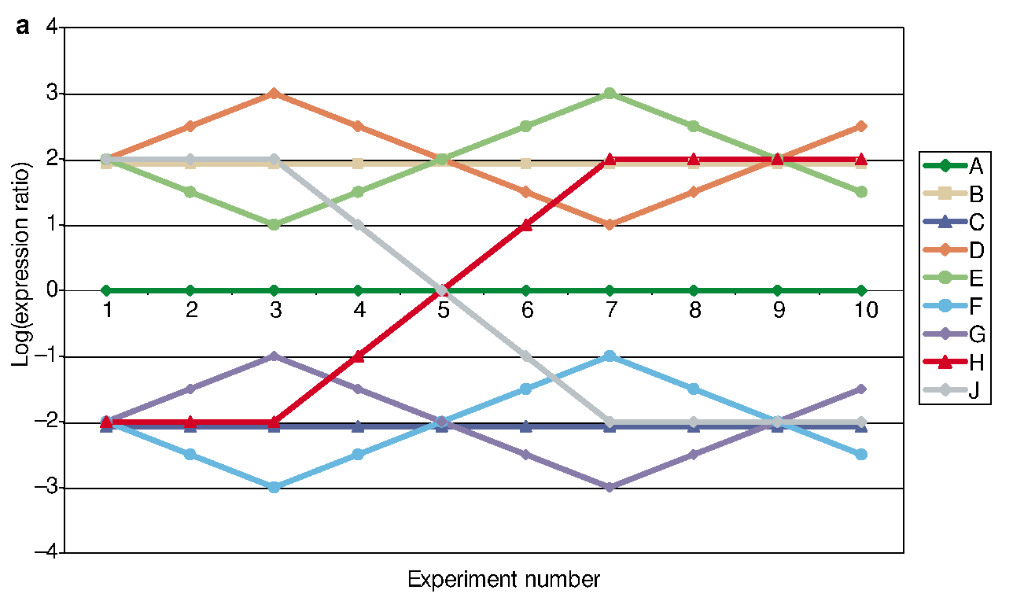
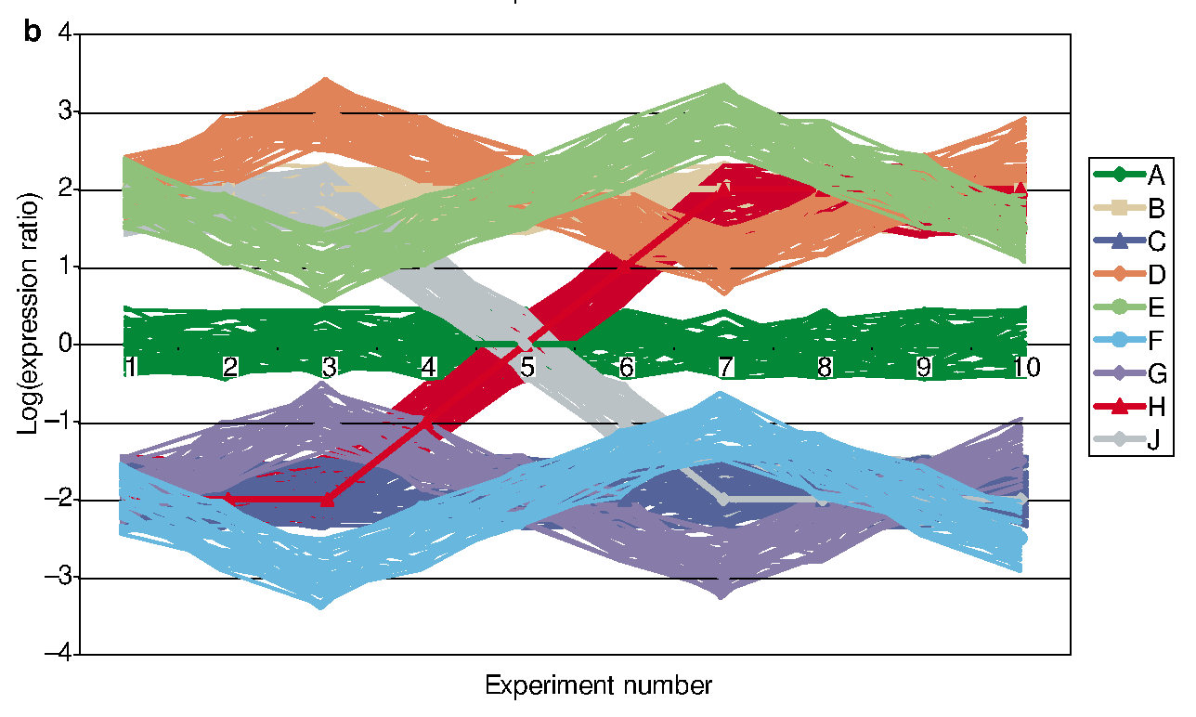
Visualisation of gene expression data (IV)
10 arrays (x-axis)
9 different profiles (A-J)
log-ratio (y-axis)
- round each profile 50
“noisy profiles”
Each simulated array contains
9*(1+50) = 459 spots
Quackenbush, Nature Reviews
Genetics, 2, 418-427 (2001)

Slide 17
Visualisation of gene expression data (V)

Slide 18
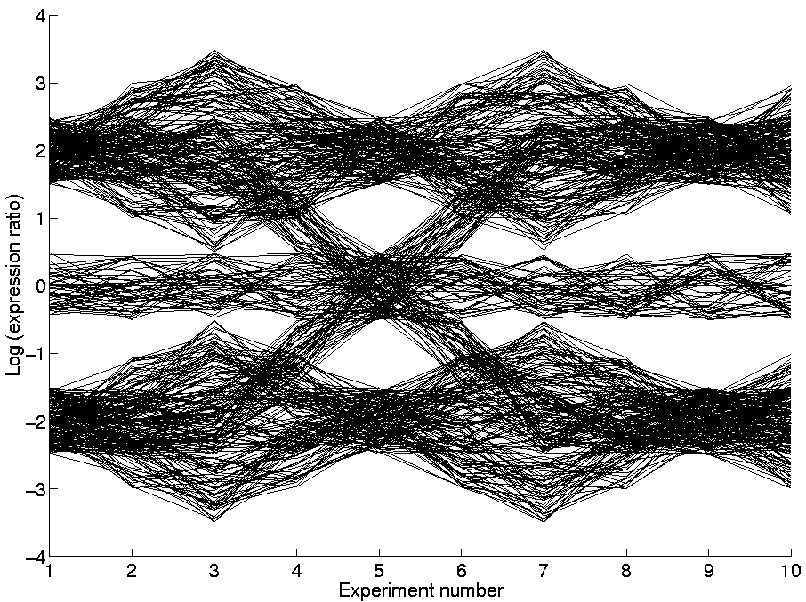
Visualisation of gene expression data (VI)
10 arrays (x-axis)
9 different profiles (A-J)
log-ratio (y-axis)
- round each profile 50
“noisy profiles”
Each simulated array contains
9*(1+50) = 459 spots

Slide 19
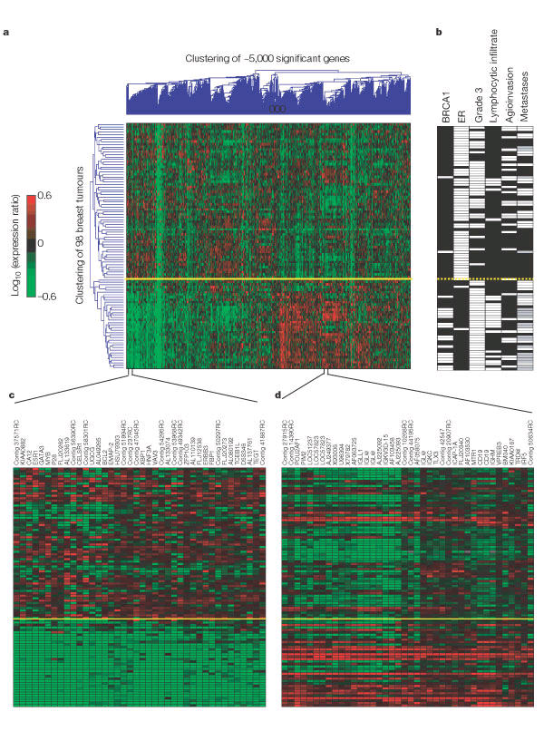
Example: genes
genes
negative
positive
samples
histopathological data
ER gene (ESR1) and genes co-regulated with ER, some of which are known ER target genes
Van ‘t Veer et al, Nature 415: 530-536 (2002)
Notes:
19
Using all genes (after filtering) two main clusters are identified: ER+ and ER-

Slide 20
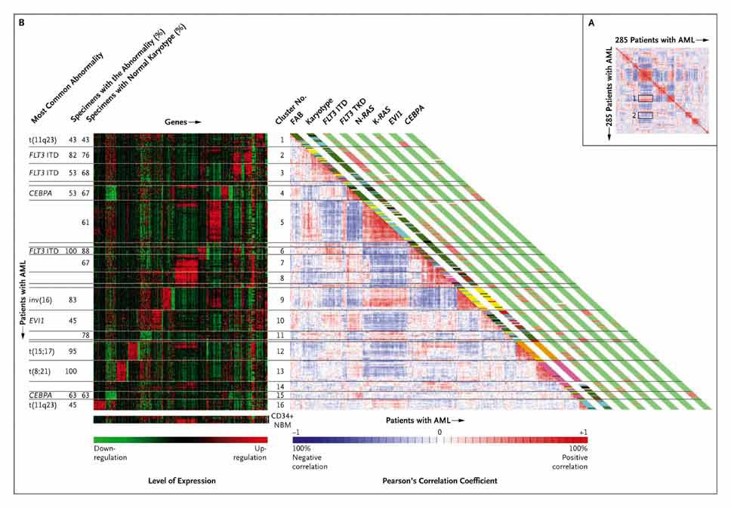
Example: samples
Identified 16 subgroups of patients with acute myeloid leukemia
Valk et al, N Engl J Med. 2004 Apr 15;350(16):1617-28.
Notes:
20
Unsupervised cluster analyses identified 16 groups of patients with AML on the basis of molecular signatures. We identified the genes that defined these clusters and determined the minimal numbers of genes needed to identify prognostically important clusters with a high degree of accuracy. The clustering was driven by the presence of chromosomal lesions (e.g., t(8;21), t(15;17), and inv(16)), particular genetic mutations (CEBPA), and abnormal oncogene expression (EVI1). We identified several novel clusters, some consisting of specimens with normal karyotypes. A unique cluster with a distinctive gene-expression signature included cases of AML with a poor treatment outcome.

Slide 21
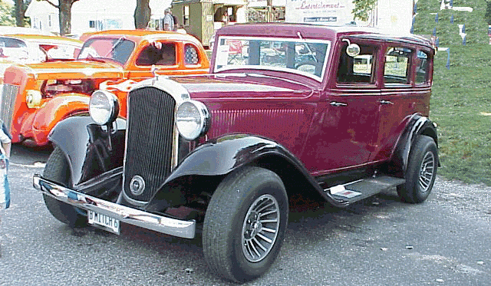
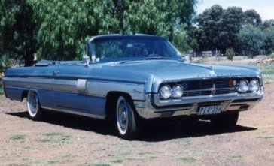
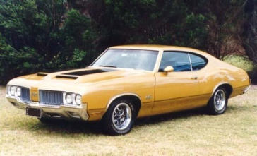
Dissimilarity measures (I)
x₂
A
C
B
x₁
Notes:
21
Next slide shows the main properties in more abstract terms

Slide 22
Dissimilarity measures (II)
s
t
r
Let be the dissimilarity between objects r and s
Formally, dissimilarity measures should satisfy
If in addition, the triangle inequality holds, the
measure is a metric
Most often used: Euclidean distance (metric)
Notes:
22
Q: what is Euclidean distance?

Slide 23
Dissimilarity measures: Euclidean (2D)
Pythagoras
c
b
a
gene g = (g₁,g₂)
gene h = (h₁,h₂)
h₁
profiles
g₂
g
g₁
g
h₂
h
g₂
d(g,h) = ?
1
2
h
h₂
g₁
h₁

Slide 24
Euclidean (general D)
h₁
profiles
g
g₂
g
g₂
d(g,h) = ?
g₁
h
h₂
h₂
h
g₁
h₁
1
2
Generalization to n dimensions:
profiles
……
g
h

Slide 25
Dissimilarity measures: example
x_{i}
t₁
t₂
t_{n}
Euclidean distance
Pearson correlation
Absolute correlation
match exact shape
ignore amplitude
ignore amplitude & sign
d( , ) < d( , )
d( , ) ≈ d( , )
d( , ) ≈ d( , )
d( , ) << d( , )
d( , ) << d( , )
d( , ) ≈ d( , )
d( , ) << d( , )
d( , ) << d( , )
d( , ) << d( , )
Example:
time series data
Notes:
25
Explain 1-rho

Slide 26
Clustering techniques (I)
Cluster problem
Partitional Techniques
Hierarchical Techniques
Graph Techniques
K-means
Mixture of Gaussians
Single linkage
Average linkage
Complete linkage
Minimum spanning tree
Within scatter
Density
Inter-object(cluster) dissimilarity
Object dissimilarity
Notes:
26

Slide 27
Clustering techniques (II)
Cluster problem
Partitional Techniques
Hierarchical Techniques
Graph Techniques
1 cluster
2 clusters
3 clusters
4 clusters
x
x
Notes:
27

Slide 28
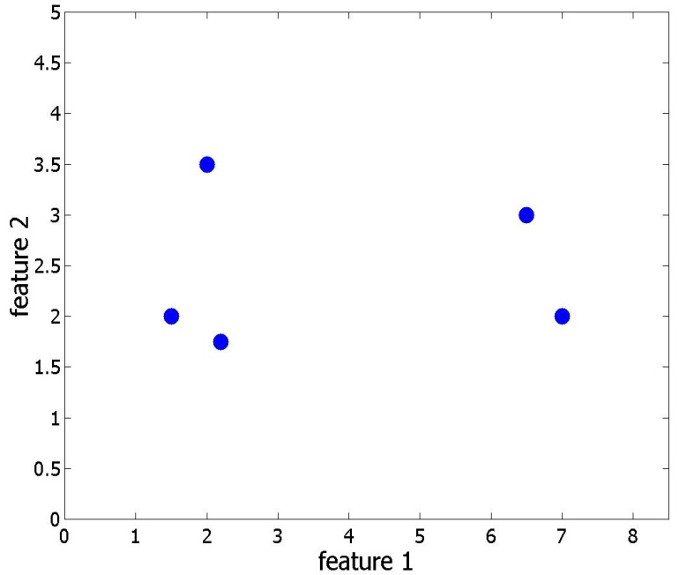
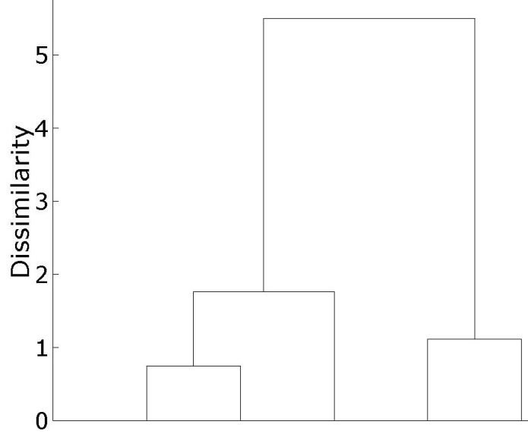
Hierarchical clustering (I)
Input:
dataset, X: [n x p], or directly:
dissimilarity matrix, D: [n x n]
linkage type
Output:
dendrogram
x₁
x₅
x₂
x₃
x₄
x₂
x₃
x₁
x₄
x₅
Notes:
28
Dissimilarity matrix: can also be [pxp]. Briefly explain the interpretation of the dendrogram.

Slide 29
Hierarchical clustering (II)
Algorithm (agglomerative clustering)
- Start: all objects of X in a separate cluster
- Clustering: combine the 2 clusters with the shortest distance
in dissimilarity matrix, D
- Repeat till only 1 cluster is left
Notes:
Agglomerative: bottom-up

Slide 30
Hierarchical clustering (II)
Algorithm (agglomerative clustering)
- Start: all objects of X in a separate cluster
- Clustering: combine the 2 clusters with the shortest distance
in dissimilarity matrix, D
Distance between clusters is based on linkage type:
  single, average, complete, …
- Repeat till only 1 cluster is left

Slide 31
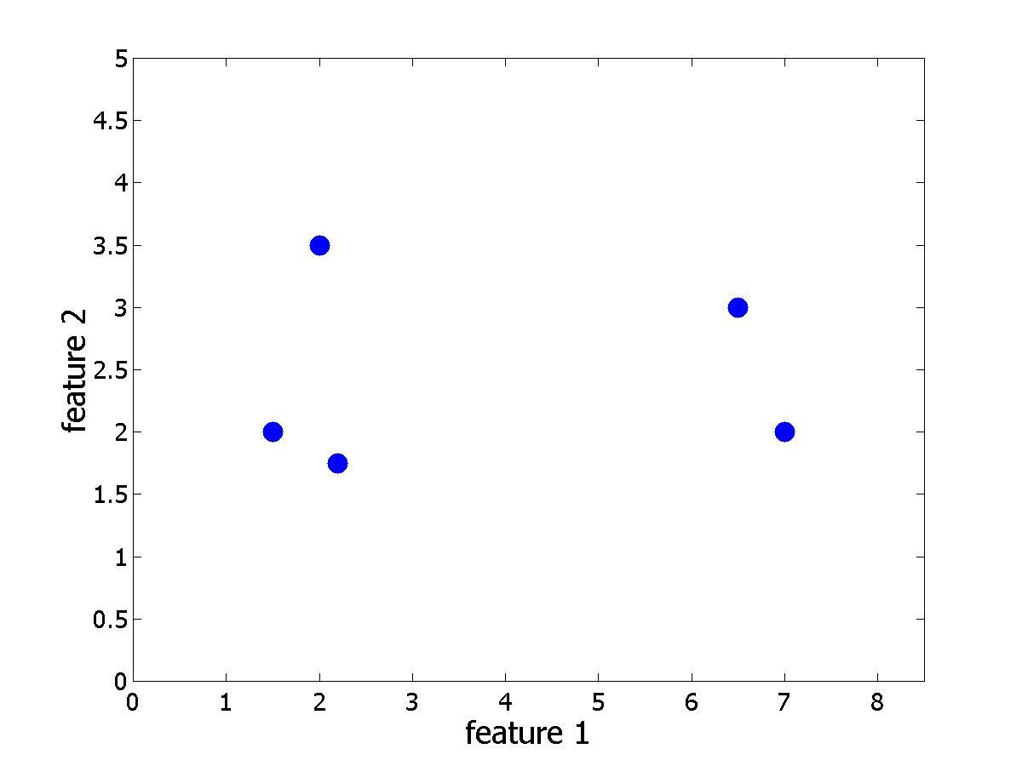
Hierarchical clustering (III)
Dataset Euclidean distance matrix, D
x₁
x₅
x₂
x₄
x₃
Notes:
31
Q: which ones are most similar? (see next slide for the answer)

Slide 32
Hierarchical clustering (IV)
Step 1:
Find the most similar pair of objects: min_{(i,j)}{d(i,j)} = d(2,3)
x₁
x₅
x₂
x₃
x₄
Notes:
32

Slide 33
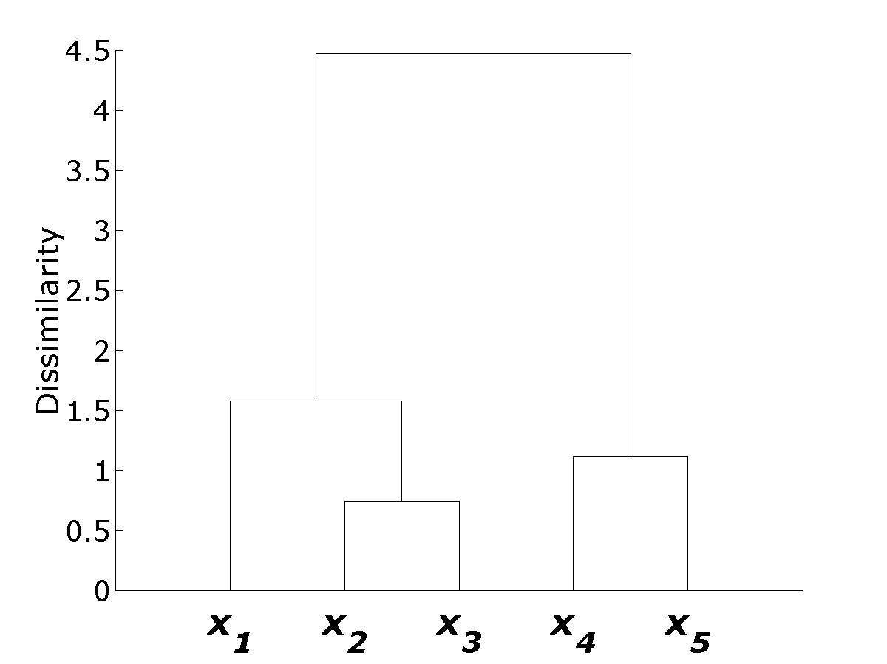
Hierarchical clustering (V)
Step 2:
Merge x₂ and x₃ into a single object, [x₂, x₃];
0.74
x₁
x₂
x₃
x₄
x₅
Notes:
33

Slide 34
Hierarchical clustering (VI)
Step 3:
Recompute D –
what is the distance between [x₂, x₃] and the rest?
x₁
x₅
x₄
[x₂, x₃]
Notes:
34
Q: how to compute the dissimilarity between [x2,x3] and the rest?

Slide 35
Hierarchical clustering (VII)
Step 3:
Recompute D –
single linkage: d([x₂,x₃],x₁) = min(d(x₁,x₂),d(x₁,x₃))
x₁
[x₂, x₃]
x₂
x₃
Notes:
35

Slide 36
Hierarchical clustering (VIII)
Step 3:
Recompute D –
complete linkage: d([x₂,x₃],x₁) = max(d(x₁,x₂),d(x₁,x₃))
x₁
[x₂, x₃]
x₂
x₃
Notes:
36

Slide 37
Hierarchical clustering (IX)
Step 3:
Recompute D –
average linkage: d([x₂,x₃],x₁) = mean(d(x₁,x₂),d(x₁,x₃))
x₁
[x₂, x₃]
x₂
x₃
Notes:
37

Slide 38
Hierarchical clustering (X)
Step 3:
Recompute D – single linkage:
Notes:
38
Now we are going to use single linkage, since calculations are easy. In general, single linkage is rarely used (I’ll come back to this later). Q: what are the recomputed dissimilarities

Slide 39
Hierarchical clustering (XI)
Repeat, step 1:
Find the most similar pair of objects: min_{(i,j)}{d(i,j)} = d(4,5)
x₁
x₅
x₂
x₃
x₄
Notes:
39

Slide 40
Hierarchical clustering (XII)
Repeat, step 2:
Merge x₄ and x₅ into a single object, [x₄,x₅];
1.12
x₁
x₂
x₃
x₄
x₅
Notes:
40

Slide 41
Hierarchical clustering (XIII)
Repeat, step 3:
Recompute D (single linkage):
Notes:
41

Slide 42

Hierarchical clustering (XIV)
x₁
x₅
x₂
x₄
x₃
x₁
x₂
x₃
x₄
x₅
Repeat steps 1-3 until a single cluster remains...
Notes:
42

Slide 43
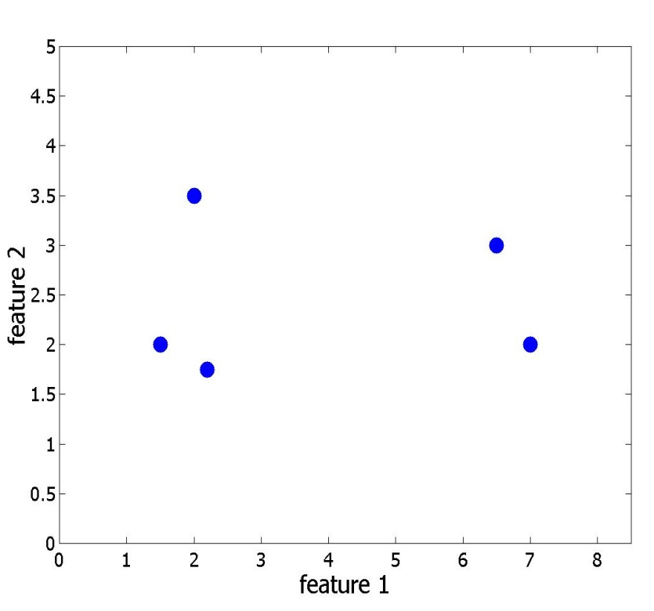
Hierarchical clustering (XV)
Dissimilarity matrix
Dendrogram
Clustering
CLUSTER
CUT
CUT
x₁
CUT
x₁
CUT
x₅
x₅
x₂
x₂
x₄
x₄
x₃
x₃
x₁
x₂
x₃
x₄
x₅
Notes:
43

Slide 44
Hierarchical clustering: summary
Hierarchical clustering: repeatedly group closest clusters
Important choices:
  Distance measure
  between objects:
  Euclidean, correlation,
  Hamming, Minkowski, ...
  Linkage
  between clusters:
  single, average, complete
Distance
Single
linkage
Average
linkage
Complete
linkage
Notes:
44

Slide 45
Hierarchical clustering: example (I)
array
gene expression data matrix
A B C D E
gene1 5 3 3 -1 0
gene2 3 1 2 -3 -4
gene3 2 0 -1 -3 -3
gene4 1 -1 0 -4 -4
gene
n experiments
p genes
genes: vectors in R^{n}
arrays: vectors in R^{p}
Often p>>n

Slide 46
Hierarchical clustering: example (II)

Slide 47
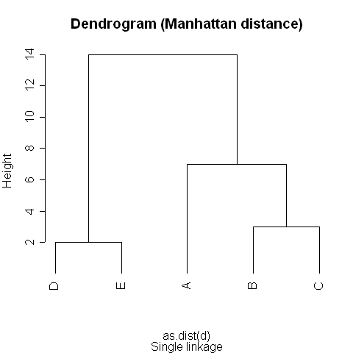
Hierarchical clustering: example (II)
Notes:
Explain Manhattan distance

Slide 48
Hierarchical clustering: example (III)

Slide 49
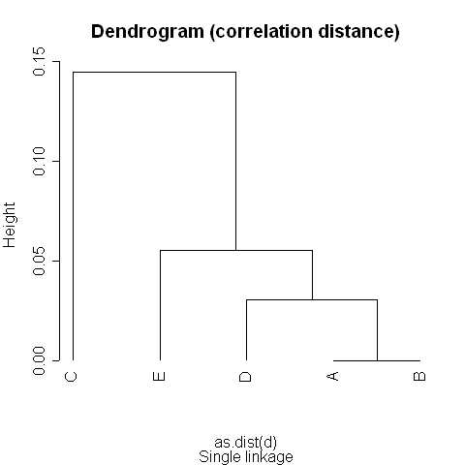
Hierarchical clustering: example (III)

Slide 50
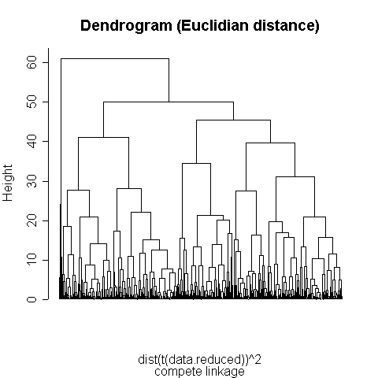
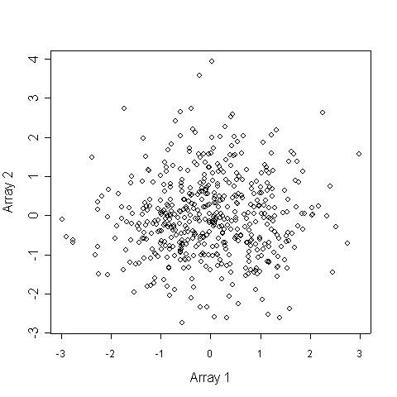
Hierarchical clustering: structure or no structure?
Cluster 500 genes, 5 arrays:
Data were random …
Validation is needed
CUT
6 clusters
Notes:
50

Slide 51
Clustering: sensitive to scale
weight
length (cm)
scaling of variables
weight
length (m)

Slide 52
Hierarchical clustering: take home message
Advantages:
  dendrogram gives overview of all possible clusterings
  linkage type allows to find clusters of varying shapes (convex and non-convex)
  different dissimilarity measures can be used
Disadvantages:
  computationally intensive:
  O(n²) in complexity and memory
  clusterings limited to “hierarchical nestings”
Notes:
52

Slide 53
Sum-of-squares clustering (I)
Dissimilarity matrix
Dendrogram
Clustering
CLUSTER
CUT
1. Data
2. Criterion
3. # of clusters
Clustering
CLUSTER
CUT
Hierarchical:
Sum-of-squares:
Notes:
53

Slide 54
Sum-of-squares clustering (II)
Within and between scatter:
x₁
x₅
m
m₁
m₂
x₂
x₄
x₃
Notes:
54

Slide 55
K-means (I)
Minimize:
x₁
(sum of cluster within-scatters)
m₁
Tr(S_{W})
x₂
x₃
0
1
Number of clusters (g)
n
Notes:
55
Tr = trace = diagonal of matrix
Note: only within scatter, not between scatter

Slide 56
K-means (II)
Iterative procedure to search for min(Tr(S_{W})):
  choose number of clusters (g)
  position prototypes (m_{j}, j=1,…,g) randomly
  assign samples to closest prototype
  compute mean of samples assigned to
  same prototype: new prototype position
  Repeat steps 3 and 4 as long as prototypes move
Notes:
56

Slide 57
K-means (III)
m₁
x₁
m₂
x₅
x₂
x₄
m₃
x₃
Step 1: Choose number of clusters/prototypes
Step 2: Position prototypes randomly
Notes:
57

Slide 58
K-means (IV)
m₁
x₁
m₂
x₅
x₂
x₄
m₃
x₃
Step 3: Assign samples to closest prototype
Notes:
58

Slide 59
K-means (V)
m₁
x₁
m₂
x₅
m₁
m₂
m₃
x₂
x₄
m₃
x₃
Step 4: Compute mean of samples assigned to same
prototype: new prototype positions
Notes:
59

Slide 60
K-means (VI)
x₁
m₂
x₅
m₁
m₃
x₂
x₄
x₃
Repeat as long as prototype positions change:
  Step 3: Assign samples
  Step 4: Recompute prototype positions
Notes:
60

Slide 61
K-means problems (I)
Clustering depends on initialization
m₁
x₁
m₂
x₁
x₅
x₅
x₂
x₄
m₃
x₂
x₃
x₃
x₄
m₃
x₁
x₁
x₅
x₅
m₂
x₂
x₂
x₃
x₄
x₃
x₄
m₁
Notes:
61
If there are multiple local minima …

Slide 62
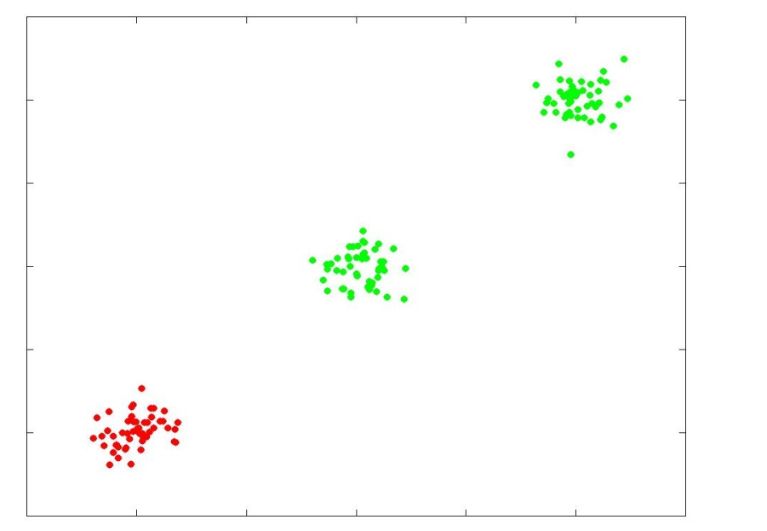
K-means problems (II)
Algorithm can get
stuck in local minima
Solution:
  start from I different
  random initialisations
  keep the best clustering
  (lowest Tr(S_{W}))
  For high-dimensional data, many restarts are
  necessary (e.g. I = 100)!
Notes:
62
Q; why is this a local minimum?

Slide 63
K-means problems (III)
Clusters can loose all prototypes
Possible solution:
  remove cluster and continue with g – 1 means
  alternatively, split largest cluster into two
  or add a random cluster to continue with g means
m₁
x₁
x₅
m₂
x₂
x₄
x₃
m₃
Notes:
63
m₃ will loose all samples. The ‘alternatively’ bullet point is not very relevant.

Slide 64
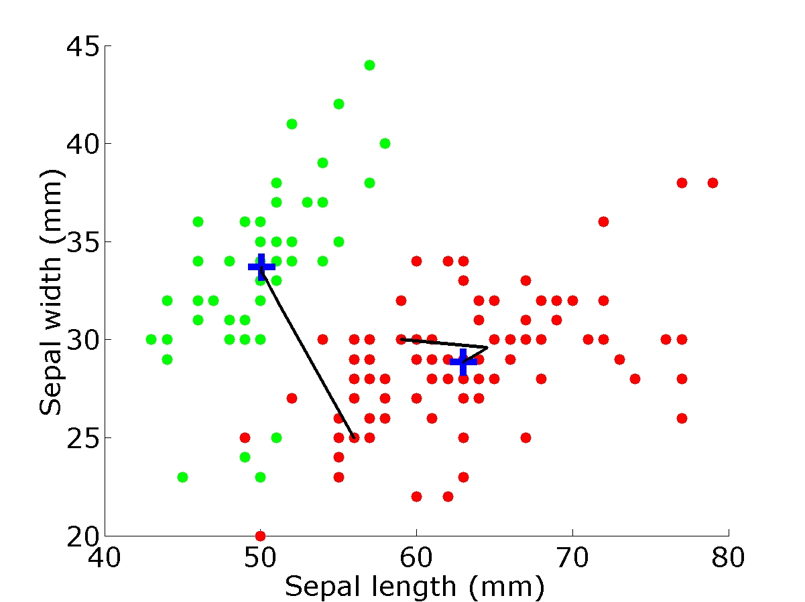
K-means example
Iris dataset
(all 4 features)
Notes:
64

Slide 65
K-means: take home message
Disadvantages:
  Finds only convex clusters (“round shapes”)
  Sensitive to initialization
  Can get stuck in local minima
Advantages:
  Very simple
  Fast
Notes:
65

Slide 66
Recapitulation
Clustering is way to detect natural groups in data
What is natural is partly subjective
We looked at:
  Hierarchical clustering
  Sum of squares (k-means) clustering
Hierarchical clustering:
  dendrogram shows a complete hierarchy of possible clusterings
  computionally intensive
K-means
  fast
  sensitive to initialization and local minima
Notes:
66

Slide 67
Cluster validation
Cluster validation:
  Checking whether grouping is really present
  Choosing the optimal number of clusters
A difficult problem – the ground truth is not known
(since we do not know the object labels)!
Methods:
  Many, here only fusion graph
Notes:
67

Slide 68
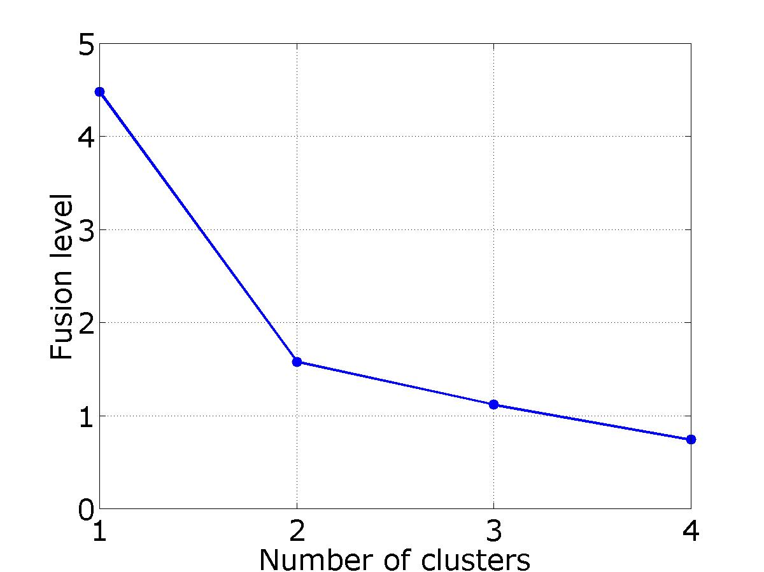


Cluster validation: fusion graph
Heuristic approach: fusion level
Cut here:
2 clusters
Large jump
x₁
x₂
x₃
x₄
x₅
Notes:
68

Slide 69
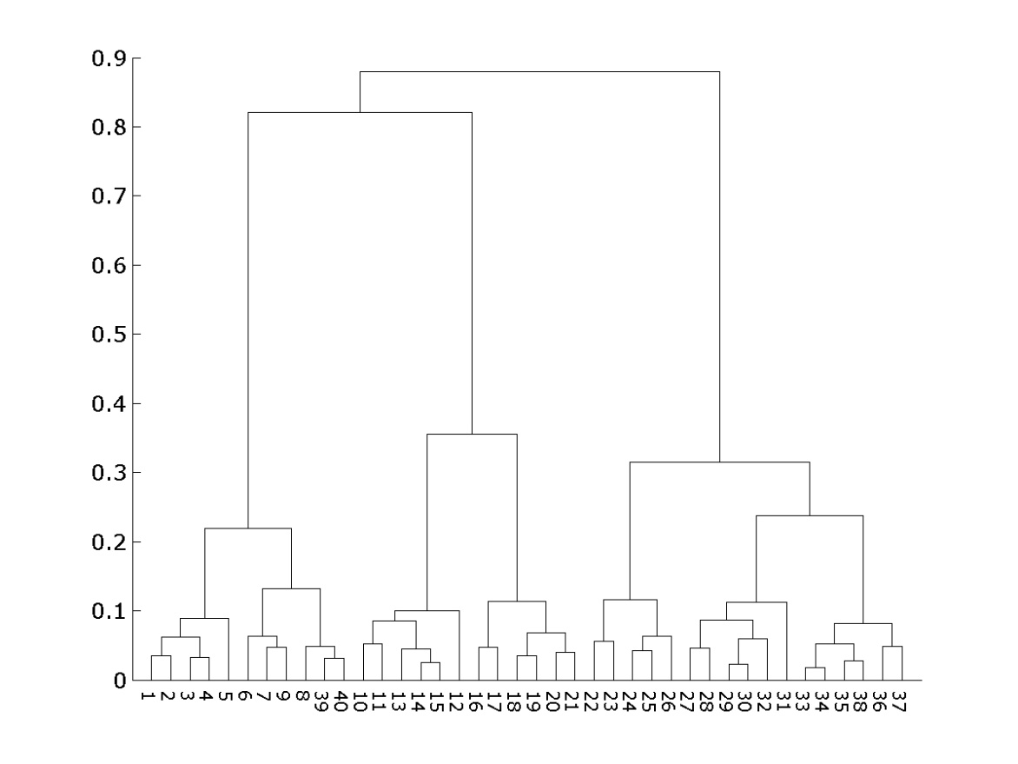
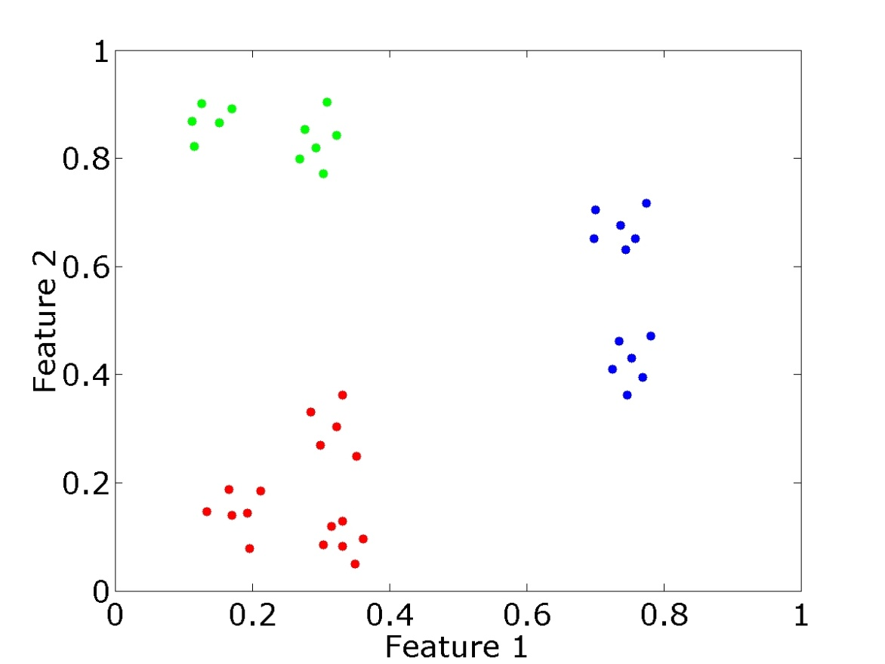
Fusion graph: example (IA)
Euclidean; complete linkage
Notes:
69

Slide 70
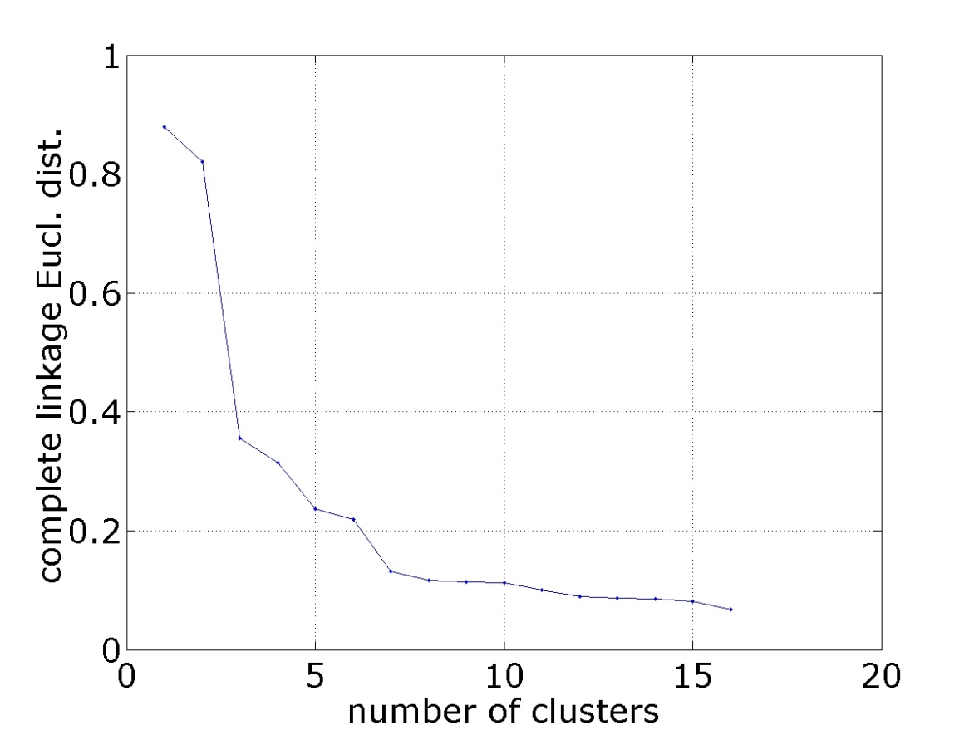
Fusion graph: example (IB)
Euclidean; complete linkage
Notes:
70

Slide 71
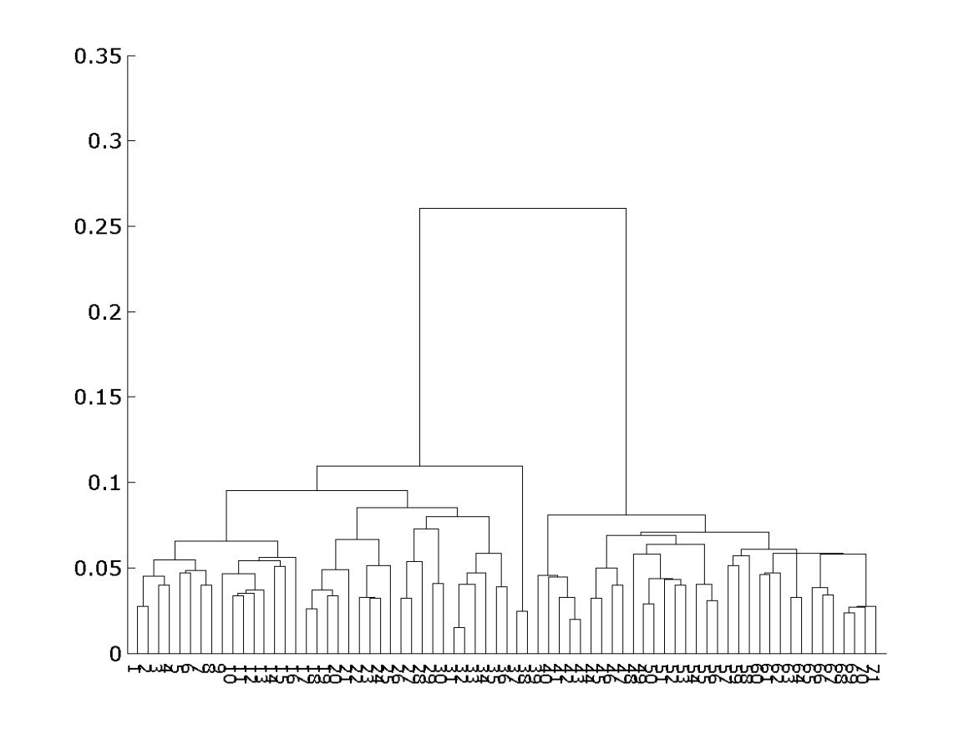
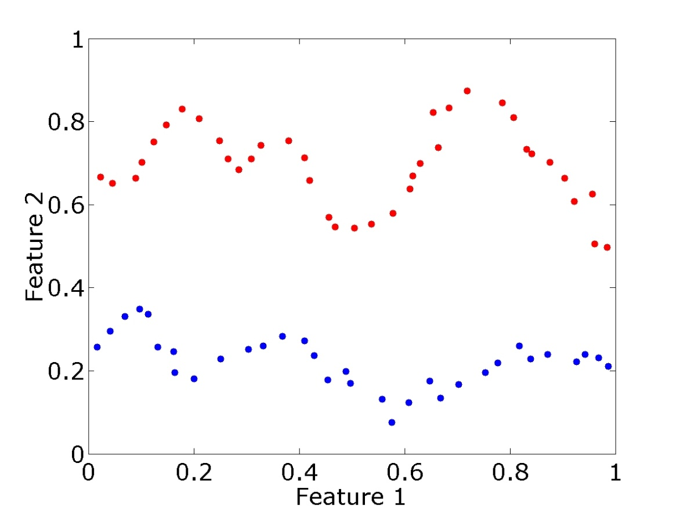
Fusion graph: example (IIA)
Euclidean; single linkage
Notes:
71

Slide 72
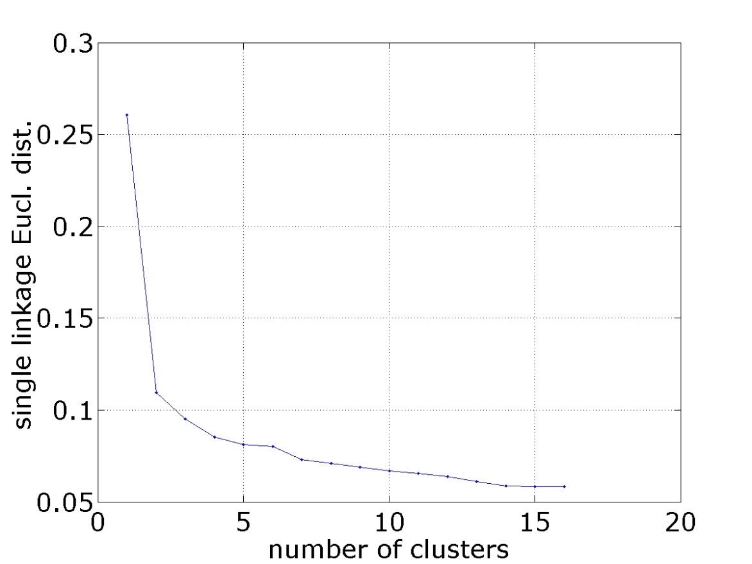
Fusion graph: example (IIB)
Euclidean; single linkage
Notes:
72

Slide 73
Fusion graph: what is large jump?
Compare the fusion graph of the dataset with a
null-hypothesis, i.e. a dataset where the clustering
structure has been destroyed
Different approaches:
  Generate random data
  within bounding box or
  convex hull of data;
  Preferable to shuffle data, i.e.
  not generate new data, but
  perturb relationships between measurements
  Randomly match feature values, i.e.
  permute values within columns (or rows)
Notes:
73
Last bullet point: of course this depends on whether you cluster columns or rows

Slide 74
Recapitulation
Cluster validation is used for:
  Assessing clustering
  Deciding on the number of clusters
Methods:
  Fusion graph, many other (and probably better) methods exist
When applying cluster validation, one also needs to define what a good cluster is – like in clustering itself.
There’s no free lunch...
Notes:
74

Slide 75
Visualization
Imagine 30,000 genes on 100 arrays:
30,000×100 expression matrix
computationally complex: reduce dimensionality
difficult to plot: reduce to 2D or 3D
Principal component analysis (PCA): linear projection on selected rotated axes
Retain as much of the structure/information as possible

Slide 76
PCA: dimensionality reduction (I)
Can be reduced to two dimensions
without information loss
y
x
z

Slide 77
PCA: dimensionality reduction (II)
Can be reduced to two dimensions
without information loss
y
x
Simply project on x-y plane

Slide 78
PCA: dimensionality reduction (III)
Can be reduced to two dimensions
without information loss
But not by projecting on the axes
y
x
z

Slide 79
PCA: dimensionality reduction (IV)
Rotate axes
PC1
PC2
PC3

Slide 80
PCA: dimensionality reduction (V)
Rotate axes and project
PC2
PC1

Slide 81
PCA: largest variance (I)
In general, one looses some information when projecting
onto a smaller number of axes
PCA: keep axes along which the spread (variance) is largest

Slide 82
PCA: largest variance (II)
PC2
PC1
First principal component (PC1) retains most of the variance

Slide 83
PCA: example (I)
PC1
PC2
PC2
Projection on
PC2: clusters
merge
Projection on PC1: 2 clusters
PC1

Slide 84
PCA: example (II)
PC2
PC2
PC1
Projection on
PC2: two
clusters
Projection on PC1: clusters are merged
PC1

Slide 85
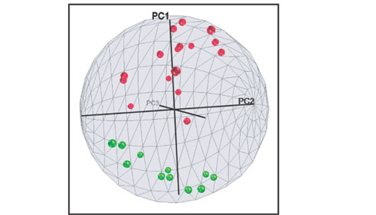
PCA: visualization
many metastases
few metastases
Yu et al., Nature Medicine, 10: 175-181 (2004)

Slide 87
PCA: take home message
6
4
2
0
-2
-4
-6
-5
0
5
PCA:
  Is global and linear
  Is unsupervised (but we can do PCA on each class)
  Needs a lot of data to estimate Σ well
Disadvantage:
criterion is not necessarily related
to the goal; might discard important
directions
Notes:
Explain or leave it covariance matrix

Slide 88
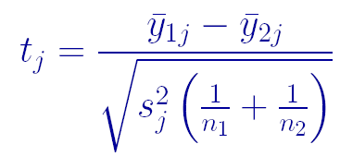

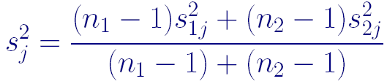
Differential expression: genewise two-sample t-test
mean of treatment 1 observations for gene j
mean of treatment 2 observations for gene j
pooled variance estimate of
variance of trt 1 observations for gene j
variance of trt 2 observations
for gene j

Slide 89
Differential expression: few degrees of freedom
Variance estimates based on few degrees of freedom can be unreliable
Problematic if our model for the data is not quite right
Variances that are severely underestimated: false positives
Variances that are severely overestimated: loss of power for detecting differentially expressed genes.

Slide 90


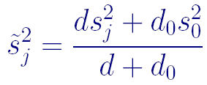
Differential expression: shrinkage
Standard t-statistics:
Shrink the individual estimate towards
degrees of freedom
d₀ and s₀ estimated across all genes
Notes:
This slide definitely needs some more background …

Slide 91
Multiple testing
Say that you perform a statistical test with a 0.05 threshold, but you repeat the test on twenty different observations.
Assume that all of the observations are explainable by the null hypothesis.
What is the chance that at least one of the observations will receive a p-value less than 0.05?

Slide 92
Multiple testing
Say that you perform a statistical test with a 0.05 threshold, but you repeat the test on twenty different observations.
Assume that all of the observations are explainable by the null hypothesis.
What is the chance that at least one of the observations will receive a p-value less than 0.05?
Pr(making a mistake) = 0.05
Pr(not making a mistake) = 0.95
Pr(not making any mistake) = 0.95²⁰ = 0.358 (independence)
Pr(making at least one mistake) = 1 - 0.358 = 0.642
There is a 64.2% chance of making at least one mistake

Slide 93
Bonferroni correction
Divide the desired p-value threshold by the number of tests performed
For the previous example, 0.05 / 20 = 0.0025
Pr(making a mistake) = 0.0025
Pr(not making a mistake) = 0.9975
Pr(not making any mistake) = 0.9975²⁰ = 0.9512 (independence)
Pr(making at least one mistake) = FWER = 1 - 0.9512 = 0.0488
The probability of one of the total number of tests being wrongfully said to be significantly different is of magnitude α = 0.0488 (≤0.05)
This is actually the Šidák correction, when not assuming independence one gets the Bonferroni correction:
  controls the Family Wise Error Rate (FWER) at α = 0.05
Greatly increases the number of false negatives

Slide 94
False discovery rate (FDR)
R = # rejected hypotheses = # discoveries
V of these may be in error = # false discoveries
The error (type I) in the entire study is measured by
i.e. the proportion of false discoveries among the discoveries (0 if none found)
FDR = E(Q)
Notes:
Inspecting 100 features:
3 false ones among 60 discovered – acceptable
3 false ones among 4 discovered - unacceptable

Slide 95
Experimental design trinity
Randomization – random assignment of treatments to experimental units (samples)
Blocking – grouping similar experimental units together and assigning different treatments within such groups of experimental units
Replication – applying a treatment independently to two or more experimental units

Slide 96
Why are these bad experimental designs?
Study: cancer versus normal
Sample collection: blood specimens for the cancer group from NKI frozen after 6 hours, for the non-cancer group from AMC immediately frozen
Handling: cancer specimens have been thawed and refrozen five times; non-cancer specimens only once
Experiment: cancers and non-cancers hybrized to microarrays on different days

Slide 97
Why are these bad experimental designs?
Study: cancer versus normal
Sample collection: blood specimens for the cancer group from NKI frozen after 6 hours, for the non-cancer group from AMC immediately frozen
Handling: cancer specimens have been thawed and refrozen five times; non-cancer specimens only once
Experiment: cancers and non-cancers hybridized to microarrays on different days
Confounding: the effects of two or more explanatory variables - on a response variable of interest - cannot be distinguished from one another
Explanatory variables:
  Hybridization day
  Patient status: {normal, cancer}
Response variable: mRNA expression

Slide 98
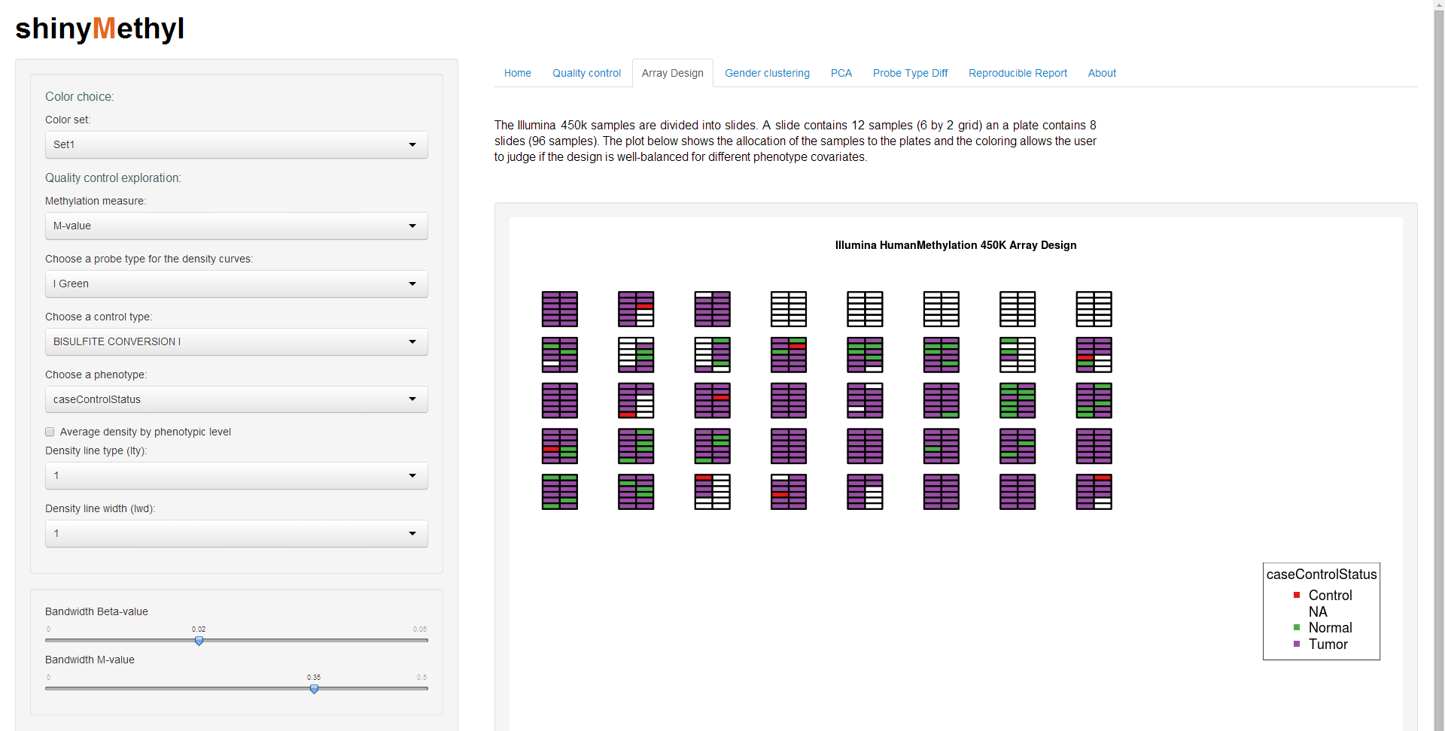
Batch effect (I)

Slide 99
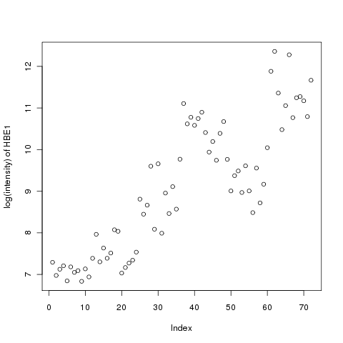
Batch effect (II)
Day x
Day y
Day y + stimulus
Arm 1: control
Arm 2: control
Arm 3: control
Arm 1: compound
Arm 2: placebo
Arm 3: placebo
Arm 1: compound
Arm 2: compound
Arm 3: placebo
Chip 1 & 2 Chip 3 & 4 Chip 5 & 6
The most differentially expressed gene for all three arms is HBE1 (hemoglobin, epsilon 1)

Slide 100
Classification (I)
Supervised: classes are defined
Goal: building models for future predictions
Feature
selection
Data
Black Box
Model
: Data
Classes
Classes
Model can not always be
represented graphically
Normal vs cancer
Cancer subtypes

Slide 101
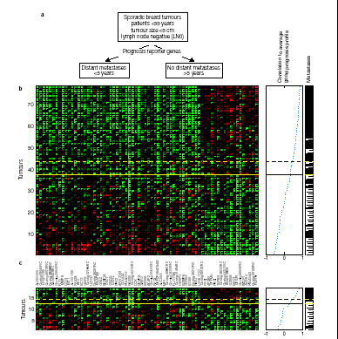
Classification (II)
Two classes:
no metastases > 5yr
metastases < 5yr
Van ‘t Veer et al, Nature 415: 530-536 (2002)

Slide 102
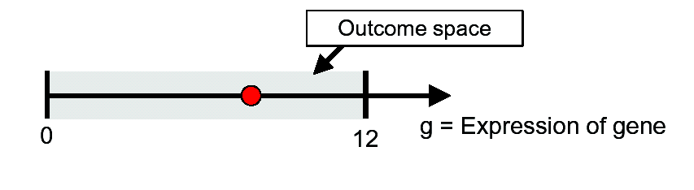
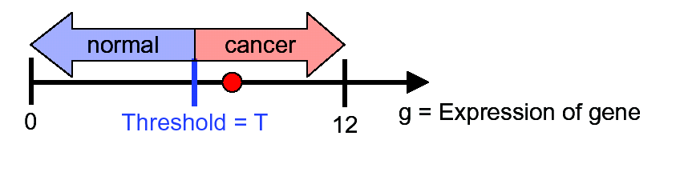
Classification: 1D example
We measure a single gene:
Classifier:
If g > T, then cancer, else normal

Slide 103
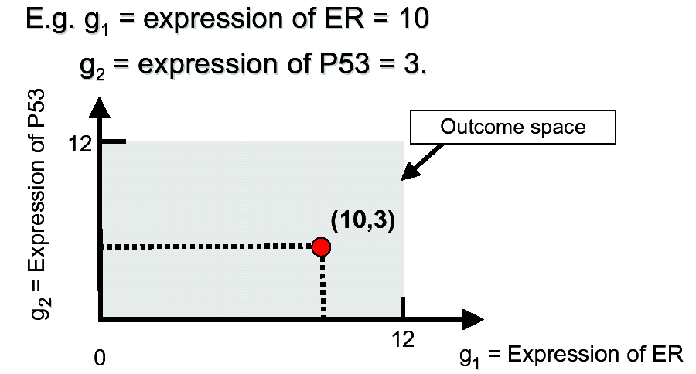
Classification: 2D example (I)
We measure two genes:

Slide 104
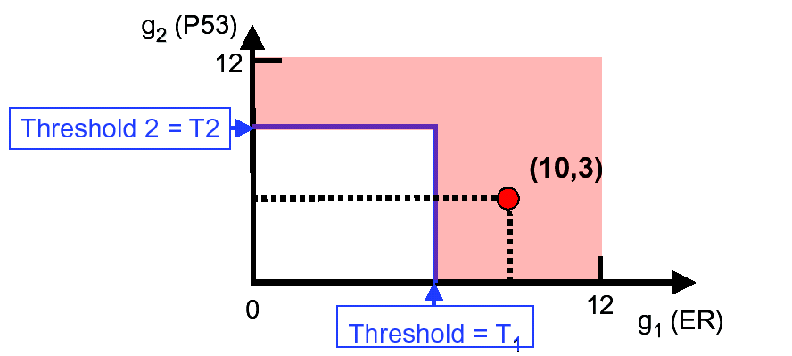
Classification: 2D example (II)
Classifier:
If g₁ > T₁ or g₂ > T₂, then cancer, else normal

Slide 105
2D: nearest centroid classifier

Slide 106

Classification: nD example
Two classes:
no metastases > 5yr
metastases < 5yr
good prognosis
78 tumors
threshold
bad prognosis
70 genes (= biomarkers)
Van ‘t Veer et al, Nature 415, 530 (2002)

Slide 107
Classification: choices made
Which genes to use
ER and P53, the 70-gene NKI signature - feature
selection
Which classifier to choose
Hundreds of possibilities. For high-dimensional
biology, often the simpler the better (p>>n)
Which value for the thresholds, i.e.
parameter estimation on collected samples optimizing
some criterion (minimal number of errors, false
negatives, false positives)

Slide 108

Classification: training

Slide 109

Classification: 1D example (I)
Is this a good choice for T?

Slide 110

Classification: 1D example (II)
For a single gene, varying T:
false positive: normal predicted as cancer

Slide 111

Classification: 1D example (III)
For a single gene, varying T:

Slide 112

Classification: 1D example (IV)
For a single gene, varying T:
false positive: normal predicted as cancer

Slide 113

Classification: 1D example (V)
Similar, but for false negative rate
false negative: cancer predicted as normal

Slide 114

Classification: 1D example (VI)
total error = FN + FP

Slide 115


1D example: validation
Final classifier:
With a large, independent test set:

Slide 116
Overfitting (I)
error
test
overfitting
training
optimum
complexity
Parameters of classifier determined on training set
Predictive power evaluated on independent test set
Balancing act: complexity & performance

Slide 117
Overfitting (II)
error
test
overfitting
training
optimum
complexity
“With four parameters I can fit an elephant, and with
five I can make him wiggle his trunk”
(John von Neumann)

Slide 118

Overfitting: example
Classifier: R²→ {+ , x}={-1 , 1}
simple, but one error
no error, but complex
decision boundary (= 0) between + and x

Slide 119
Cross-validation
Often not enough data for a separate training and test set
Solution: cross-validation (CV)
D1 D2 D3 D4 D5 D6 D7 D8 D9 D10
Example: 10-fold
Split data D in 10 parts
For each of the 10 parts
- 9/10 training data
- 1/10 test data
End: all data has been used to test – estimate test error

Slide 120

Cross-validation: 1D example
leave-one-out cross-validation: # errors/# samples = 3/10

Slide 121
First law of learning
Never use test data before testing the model.
Sounds self-evident but often not respected …. I’ve seen examples of Lancet, Nature & PNAS papers doing this wrong.
error
test (correct way)
test (wrong way)
training + test
right optimum
wrong optimum
complexity

Slide 122
Possible problems (I)
Test set is not independent
Follow-up to Van t’ Veer et al (Van de Vijver et al, NEJM 347, 1999 (2002)) uses the 70-gene signature to predict distant metastases
295 individuals but 61 were already included in Van ‘t
Veer et al.
Reported results might have been inflated.

Slide 123

Possible problems (II)
Feature selection is done
incorrectly.
All steps should be on training
data, also feature selection
Solution: validation set
Some of the results in
Van ‘t Veer et al (2002) are
inflated due to this

Slide 124

Possible problems (III)
Test set is too small or confidence intervals for
prediction are missing
Re-analysis by Michiels et al:
Michiels et al, Lancet, 365, 488 (2005)

Slide 125
Michiels et al: set-up
randomly split data (size N) in training (size n, each
outcome n/2) and test (size N - n) data (500 times)
500 simple classifiers (a la Van ‘t Veer) on 50 genes with
highest SNR in the training data
test classifiers on the 500 test sets
for increasing n

Slide 126

Classification error and error bars
NEJM, 2002
Nature, 2002
Michiels et al, Lancet, 365, 488 (2005)

Slide 127
Classification: take home message
A completely independent test set should only be used to judge performance of the final classifier
Cross-validation can help to estimate performance when little data is available
To optimise parameters of a classifier, the error should be calculated on a validation set

Slide 128
Software
R/Bioconductor
  www.r-project.org and bioconductor.org
  powerful scripting language
  Computing in R, Graduate School, March 22-26, 2021
R2
  r2.amc.nl
GenePattern
  genepattern.org
Multiple Experiment Viewer
  mev.tm4.org
Morpheus
  https://software.broadinstitute.org/morpheus/

