Slide 1
Introduction to Bioinformatics February 22, 2021
Dr. ir. Perry Moerland
Bioinformatics Laboratory
Amsterdam UMC
University of Amsterdam
p.d.moerland@amsterdamumc.nl
Graduate School ‘Bioinformatics’

Slide 2
Aim of course
Get acquainted with the basic principles and algorithms of commonly used bioinformatics tools
Gain sufficient theoretical knowledge and practical skills to be able to apply (a selection of) bioinformatics methods adequately in your own work

Slide 3
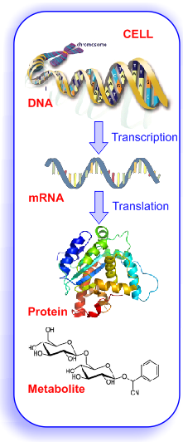
Topics (I)
Possibilities and limitations of public biological DBs
Statistical concepts for ‘omics data analysis
DNA microarray analysis
Metabolomics data analysis
Pathways and networks
Genetical genomics
Capita selecta

Slide 4
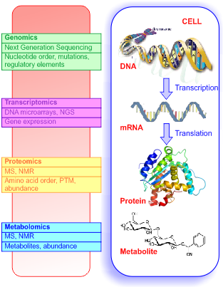
Topics (II)
Methods for the analysis of data
generated with high-throughput
technologies
Microarrays
Mass spectrometry
Next generation sequencing
Graduate School:
Bioinformatics Sequence Analysis

Slide 5
Related AMC Graduate School (and other) courses
Computing in R
Unix
e-Science (Big Data)
Bioinformatics Sequence Analysis
Systems Medicine
Practical Biostatistics
Advanced Biostatistics
Genetic Epidemiology
DNA Technology
BioSB Research School: http://biosb.nl/education/course-portfolio/
Machine Learning

Slide 6
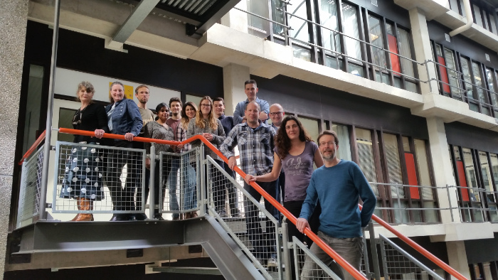
Bioinformatics Laboratory
Department of Epidemiology and Data Science
You are welcome if you need bioinformatics expertise
The earlier, the better!

Slide 7
Practical things
Certiﬁcate
Attend all sessions (half a day can be skipped, ask for possibility
for self-study)
Active participation
Course material
Slides and (answers to) computer exercises will be made available on
https://bioinformatics.amc.nl/education/gs-bioinformatics/

Slide 8
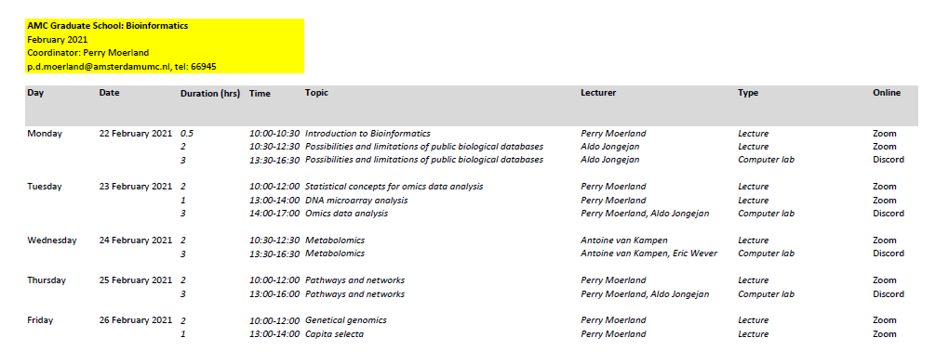
Schedule

Slide 9
Quick introduction round
Unmute yourself
Enable camera
Mention name, department, and why you are taking this course (for example, type of data) in 2 sentences!

Slide 10
Discord
VOICE CHANNELS You can also share screen/video
- Meeting room: Channel where general meetings take place
- Chill room: Channel to hang out
- TA-X-room: Channel where teachers are online
You can enter and ask questions
Do check whether other people are already there
- Room-XX: Channel for a group
TEXT CHANNELS
- General-chat: general messages to us/everyone
@here: chat to everyone online
@everyone: chat to everyone
Click on person to chat in private
- chat-XX: Chat room for a group

